Slide 1
ME599 Advanced Mechatronics Elbow Exoskeleton Final Project
BY: YUSUF WONG
Notes:
Hello. My name is Yusuf Wong, and today I’lll be presenting my Elbow Exoskeleton Final Project. I want to first give a huge shout out to Professor Hao Su, and the Doctoral teaching Assistance Selena and Bownen. They’ve definitely been a great help!

Slide 2

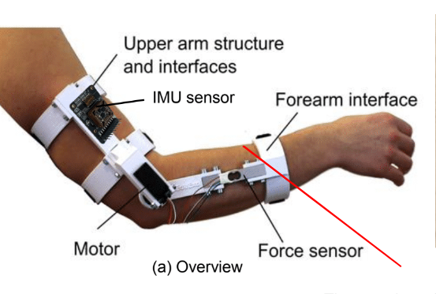
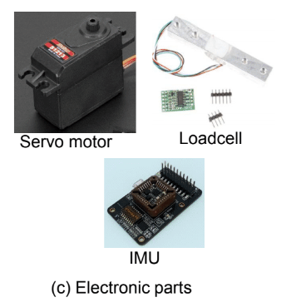
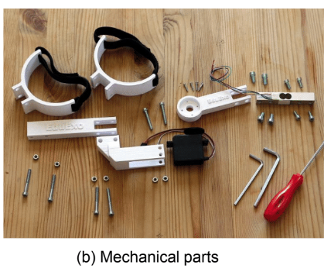
Background
Purpose
To design an Exoskeleton
Using SolidWorks to Generate Concept Designs & Assemblies
Learn Mechatronics Concepts
Arduino
Programming & Controlling Actuators such as Servos
Loadcell Sensors
Motor Control
Introduction to Biomechanics Industry
Notes:
So just some background. The purpose of this project is to design an exoskeleton that would be beneficial for both the medical industry, as well as warehouse and factory workers. This area of study is incredible useful to help anyone who would need elbow assistance, including disabled patients and factory workers who put a lot of train on their backs, limbs, and forearms when carrying and moving heavy load. The purpose of this project is to design an exoskeleton that can put less strain on a person. And we do this by using SolidWorks to generate design concepts and assemblies, as well as utilize mechatronics concepts such as Arduino programming, loadcell sensors, and motor control.

Slide 3
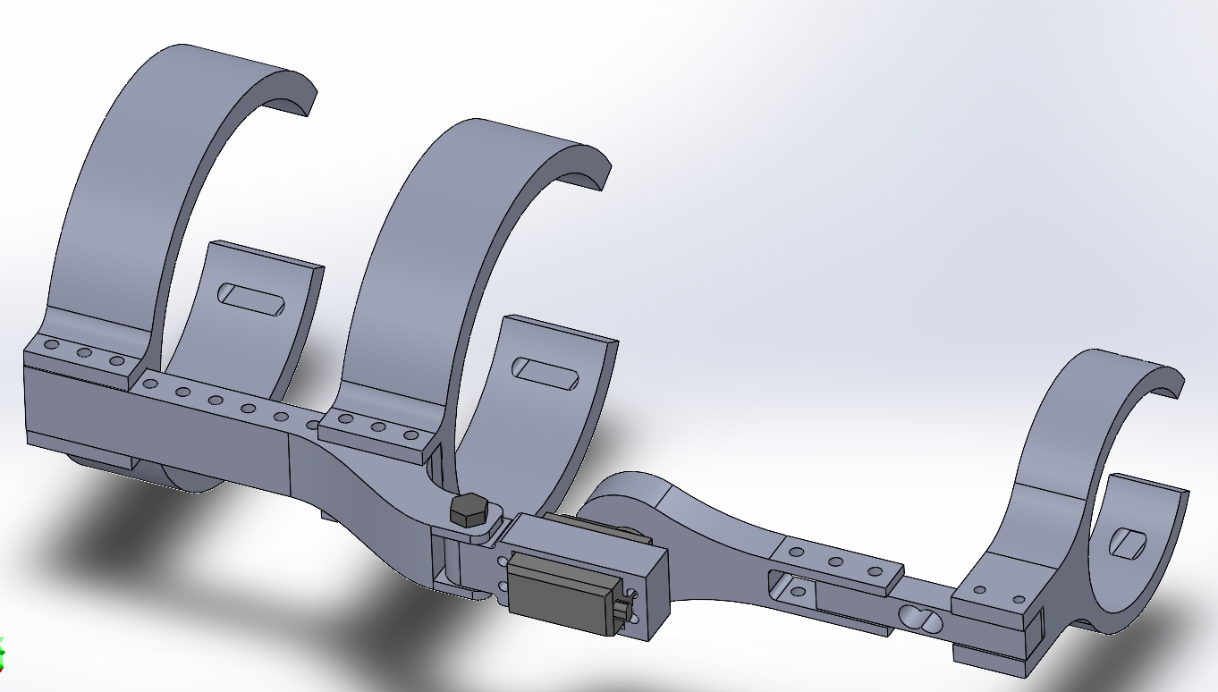
My SolidWorks Design
Notes:
So here is my SolidWorks design. There are two upper arm cuffs, a linkage to these cuffs, an Upper arm servo attachment, a high torque servo motor, a lower arm servo attachment, a bolt, a loadcell, and finally the lower arm cuff.

Slide 4
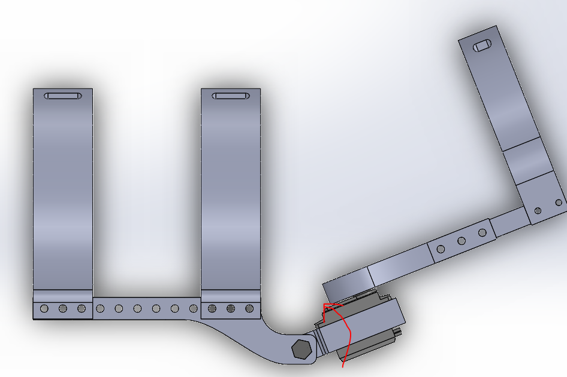
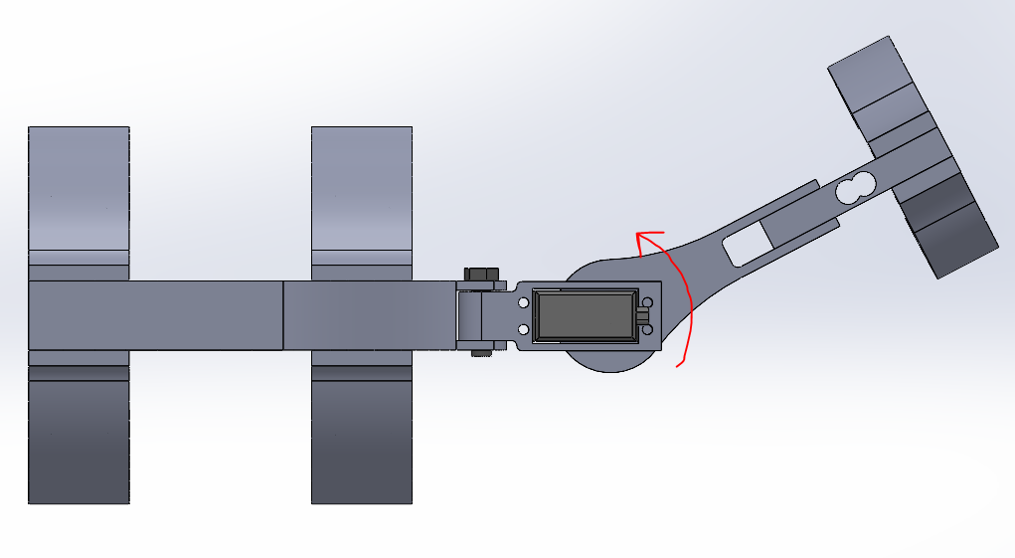
Two Degrees of Motion:
Notes:
The purpose of having that bolt is to have 2 degree of Freedom. The user would have free lateral and medial rotation, which is shown on the left image, and the servo motor would provide flexion and extension for the 2nd degree of motion. I can open up my SolidWorks file just so that you can also get an idea of how it behaves.

Slide 5
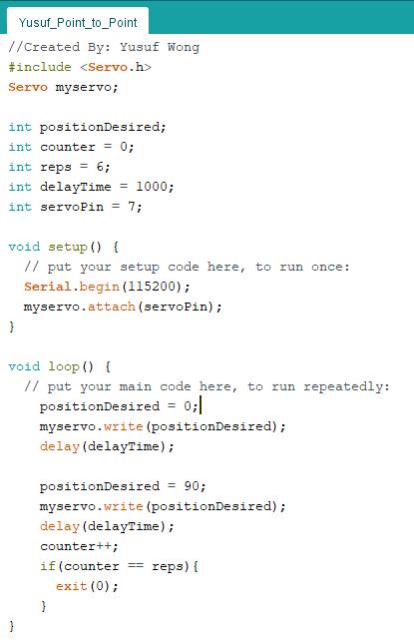
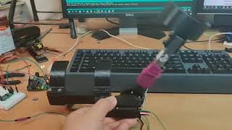
Position Control – Part 1: Point-to-Point
Notes:
So here is the Position Point to point video demonstration. We can see that the arm goes from one angle to another multiple times until it reaches a finite number of cycles.

Slide 6
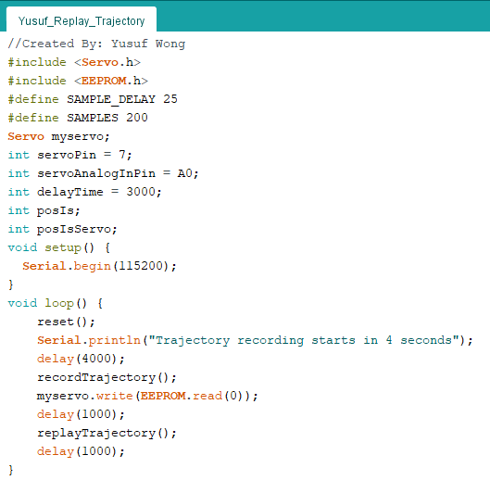
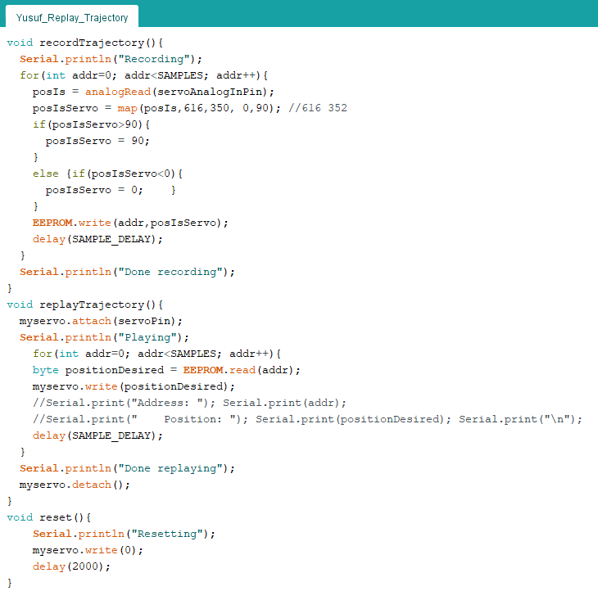
Position Control – Part 2: Replay Trajectory
Notes:
Here is Part 2 two of Position Control that use EEPROM memory management that saves the trajectory of a movement for a few seconds. This is done by taking several samples every few milliseconds which is then used to map the movement when replaying the trajectory.

Slide 7
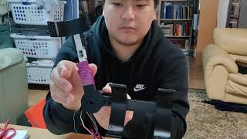
Position Control – Part 2: Replay Trajectory
Notes:
Here is a demo of the trajectory implementation.

Slide 8
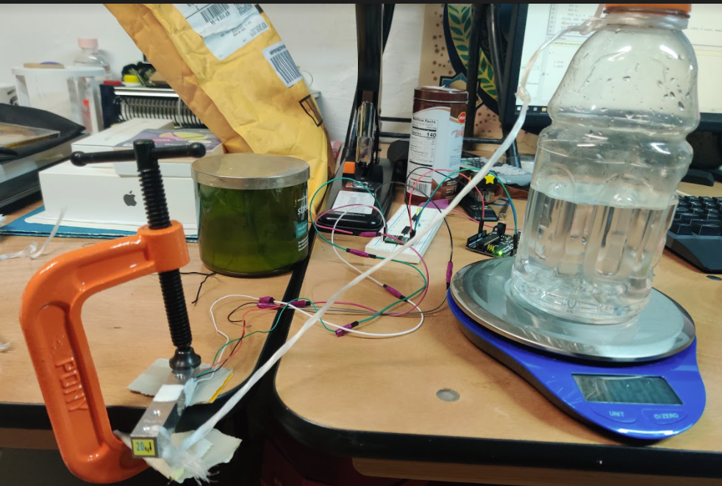
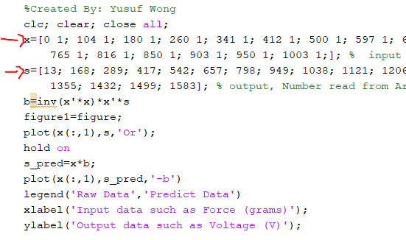
Load Cell Calibration
Notes:
For the Admittance and Virtual Wall control, I needed to use a loadcell that had to first be calibrated, so here is my trying tot get data for linear regression calibration. I took different amount of weights or grams and recorded the amplified voltage output from the loadcell, and then used MATLAB to do linear regression.

Slide 9
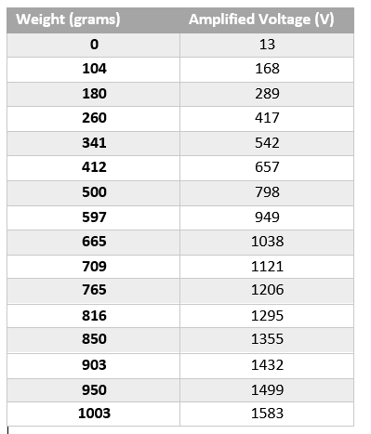
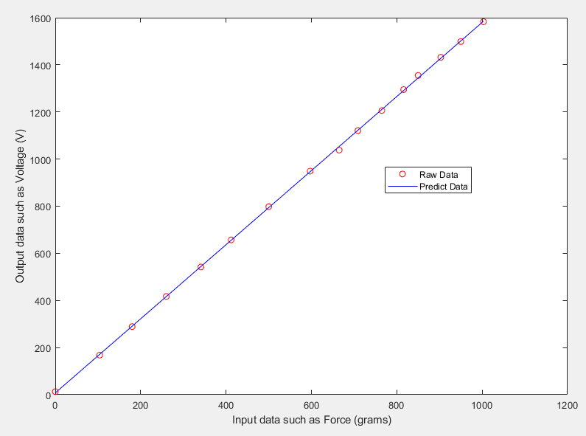
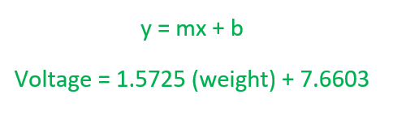
Load Cell Calibration – MATLAB Results
Notes:
I recorded 16 different weights by adding water to a bottle and measuring the mass for every datapoint. For each mass, I received certain values for amplified voltage, and was able to get a very well-established linear curve of y, which is equal to voltage, equals 1.5727 times the weight, in grams, plus 7.6603

Slide 10
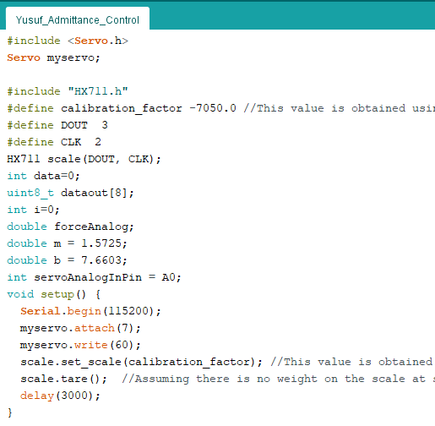
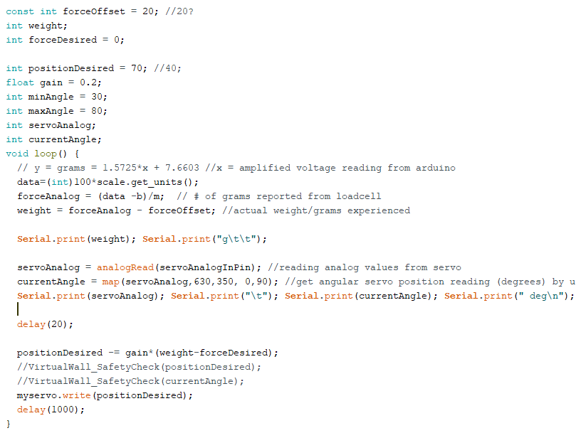
Admittance Control - Code
Notes:
So here is the code for admittance control that essentially uses the measured weight from the load cell, and whenever the loadcell experiences a certain amount of stress, or weight, the servo motor rotates to the desired position depending on the amount of load.

Slide 11
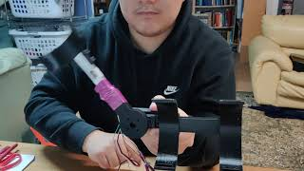
Admittance Control - Demo
Notes:
Here is a demo of the admittance control.

Slide 12
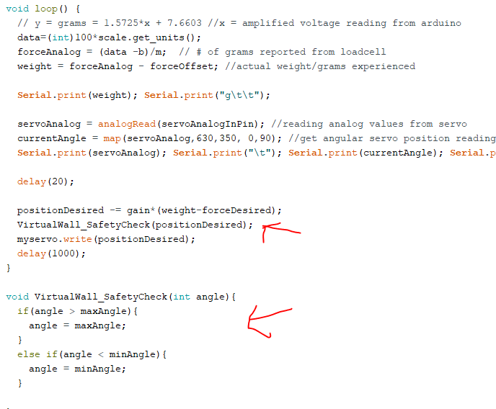
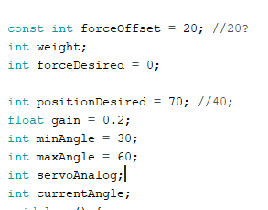
Virtual Wall Control - Code
Notes:
And finally virtual wall control. This is essentially the same as admittance control, except that now I used a virtual wall safety check function so that the positioned desired doesn’t exceed the bounds of the minimum and maximum desired angular position.

Slide 13
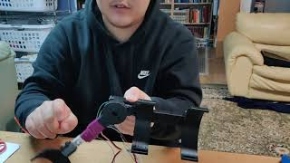
Virtual Wall Control - Demo
Notes:
Finally, here is a demo of the virtual wall control.

Slide 14
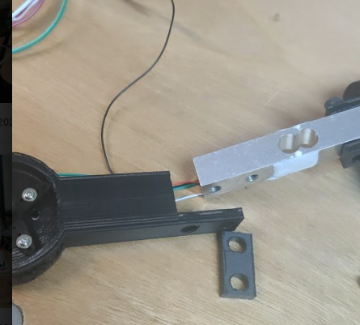
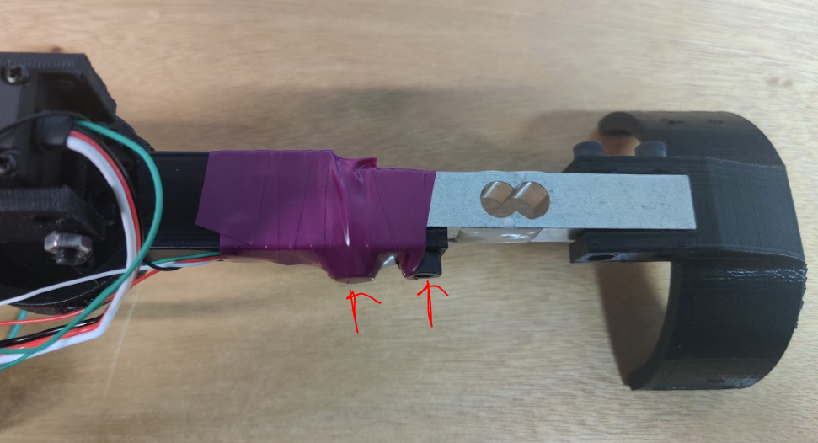
Problems/Troubleshooting:
While testing my Code with the Load Cell, and constantly trying to apply a load on the arm, the hinge broke off at the Motor Connection Interface.
I used tape and screw the screws form the bottom instead
Notes:
One big problem I had was that a piece of the Servo Motor-Load cell attachment broke off and I was scared at first because I was pressured for time to show a demo for the admittance control. But I compromised by screwing two nuts on the bottom of the attachment and then wrapping the whole thing in electrical tape as much as possible, being more careful of not pressing too hard that could easily break the other end as well.

Slide 15
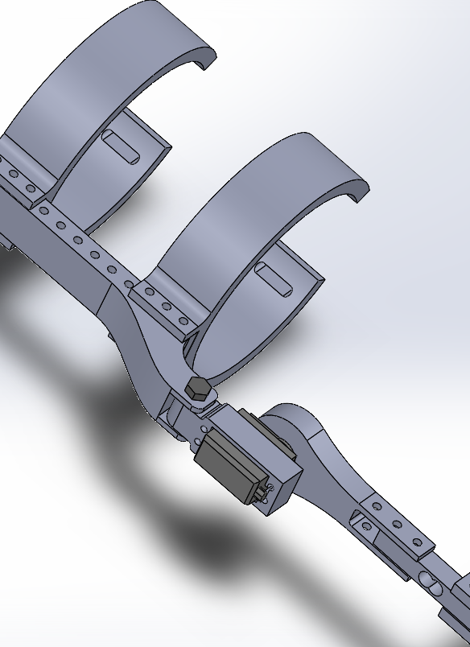
What I Learned:
How to 3D model a Robotic Arm Assembly
Understood that there are many ways of Control
Reading Load Cell Sensor Data
PID Control from Servo Motors
IMU Sensors
Arduino Programming
How to Code a Servo Motor & Control it
Reading, interpreting, and utilizing Analog Data
Servo Motor
Load Cell
Learning How to Debug & Analyze Arduino Code using Serial.println() statements
Notes:
Finally, just to summarize the things that I learned from this project. One thing I learned was understanding how to 3D model a robotic arm assembly. I also learned that there are many different ways of control, such as reading load cell sensor data, understanding how servo motors use PID control, as well as how IMU sensors work. I also learned Arduino programming of learning how to code a Servo motor and control it, as well as reading, interpreting, and utilizing analog data from both the servo and a load cell. And finally, and I think most importantly, is that I learned how to debug and analyze Arduino coding problems throughout this project by using a lot of Serial.println statements. As a computer science minor, this is very useful for the software projects in any engineering industry.

Slide 16
THANK YOU!!! (especially to the TA’s! 😁)
Notes:
Thank you, especially to the Doctoral TA’s Selena and Bowen. They’ve been an amazing help!!!!

